Slide 1
Predicting the severity of an accident

Slide 2
Introduction/Business Problem
Are you a driver? Do you know how to drive? If yes, I ensure face this problem before such as you come across a terrible traffic jam on the other side of the highway. Long lines of cars barely moving.
So I am going to predict the severity of an accident based on weather, road conditions and light conditions. It can warn you before by given the weather and the road conditions about the possibility of you getting into a car accident and how severe it would be, so that you would drive more carefully or even change your travel if you are able to.

Slide 3
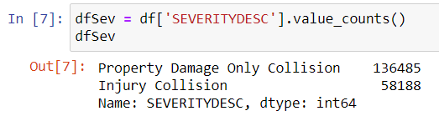
Data section
use the data that provided by the course to predict the severity of an accident based on weather, road conditions and light conditions
In target variable SEVERITYCODE is unbalanced, so I need to balance the data to get a better machine learning model. As you can see in the picture below, more than twice the amount of 1 severity code than 2.

Slide 4
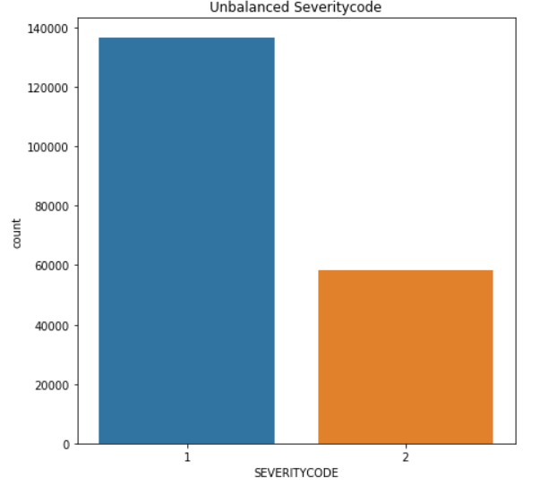
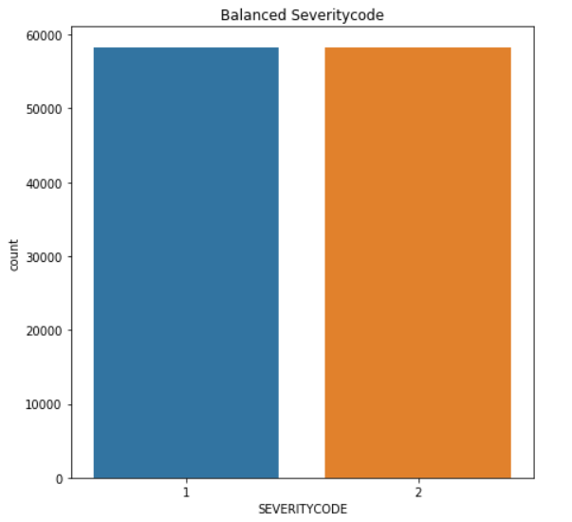
Data section
Before Balance
After Balance

Slide 5
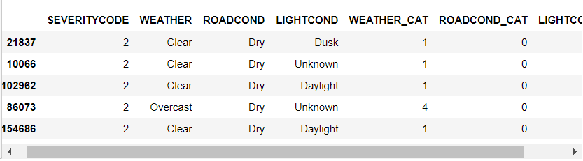
Data section
label encoding to convert the features to our desired data type

Slide 6
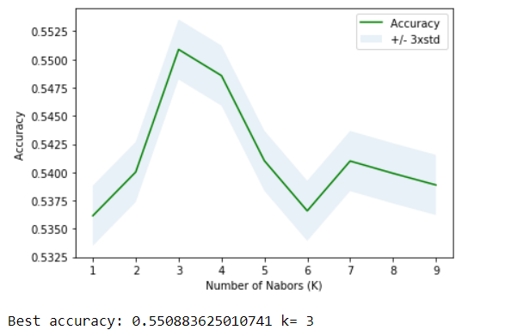
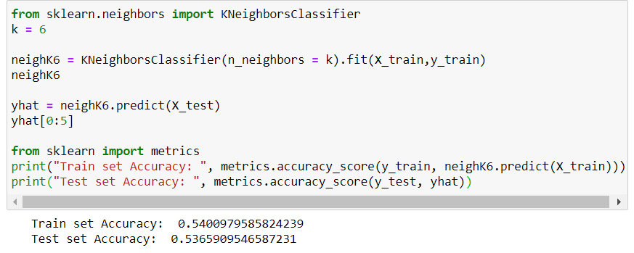
methodology
Our data is now ready to be use for machine learning models. I will use the following models to predict:
K-Nearest Neighbor (KNN)

Slide 7
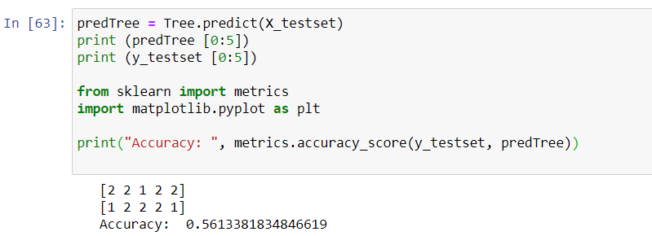
methodology
Decision Tree

Slide 8

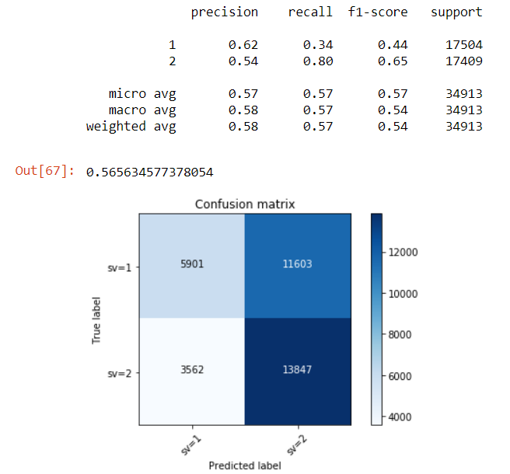
methodology
Support Vector Machine (SVM)

Slide 9
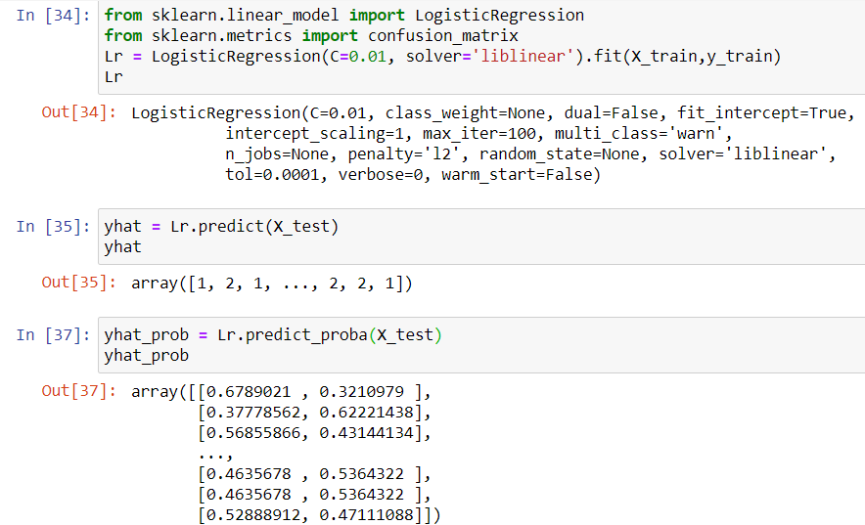
methodology
Logistic Regression

Slide 10
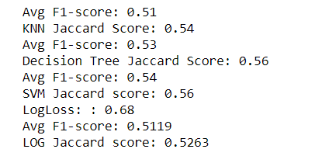

result

Slide 11
discussion
From the result section, it shown SVM is the most accuracy model to predict this case since it has the higher accuracy of Jaccard Score and F1-score compare to others.
Even though, SVM is the most accuracy model but the result of all model is almost the same. All of them are between 0.50 - 0.56 .

Slide 12
conclusion
Since the result of all model is almost the same. Its means weather, road conditions and light conditions will cause the injury collision around 50% and property damage only collision 50%. In conclusion, please pay attention when you are driving because no matter how is the weather, road condition and light conditions you still have chance to get into an accident.

Slide 13
Thank you!

